Slide 1
During Heapsort, trace the change in value of every node in the heap.
Submitted by:
Shiv Pratap Singh Nazish Tabassum Arqum Ahmed
IIT2014121 ICM2014504 IWM2014003

Slide 2
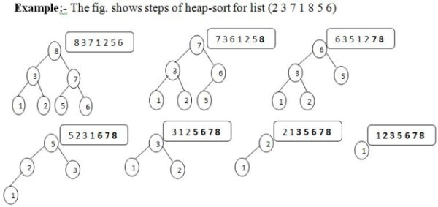
Building max-heap and sort it in ascending order

Slide 3
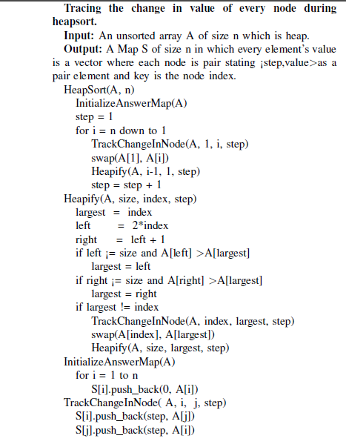
Algorithm
Time Complexity = O(nlog(n))
Considering retrieval of an element from map in O(1)

Slide 4
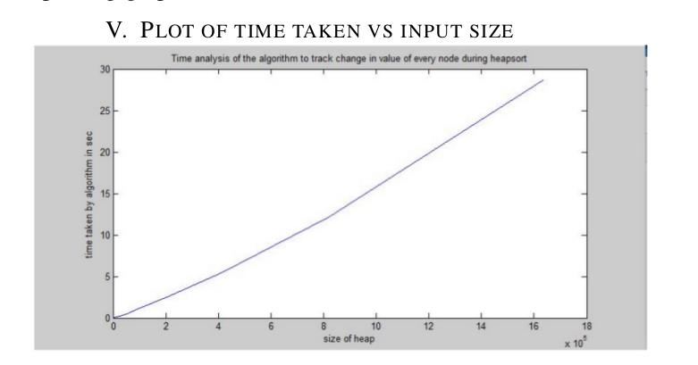

Slide 5
Thank You

